Slide 1
PUBP309: EDUCATION POLICY
Shivakumar Jolad
FLAME University
Child Labour in India – Problem and Legsilation

Slide 2
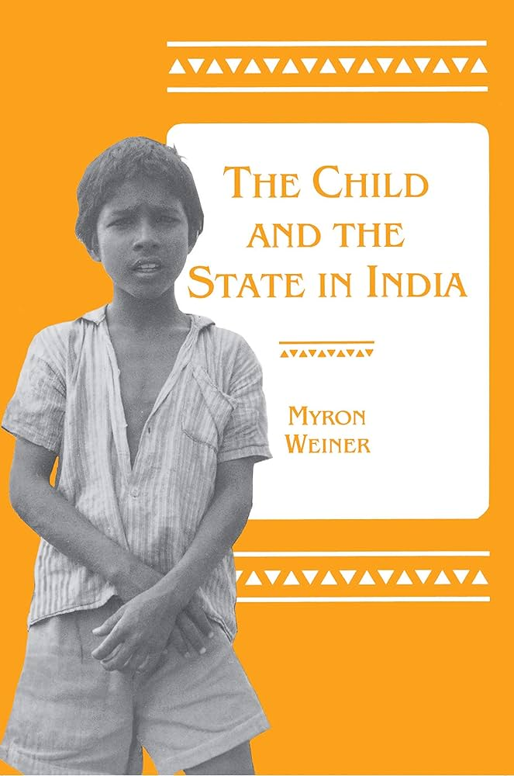
Child and the State in India (1990) CH1- The ARGUMENT
Slide support ISHA DOSHI

Slide 3
The Problem Explained
In most modern states: state is the ultimate protector of children
But in India: Primary education isn’t compulsory + child labour isn’t illegal
82.2 million children between 6-14 years are not in school, 13.6-44 million work as child labourers
Indian law prohibits child labour in factories, but not in cottage industries, family households, restaurants or agriculture
Time period: 1985-1990
Notes:
Modern states see it as their legal duty and not merely a right to ensure that parents send their children to school and they children attend school

Slide 4
The Problem Explained: Country Comparisons
Poverty has never historically been a deterrent for introducing compulsory education, neither has low per capita income
Eg: African countries like Botswana, Gambia, Ghana, Libya, etc.
China: comparable illiteracy rate to India 40 years ago, has now halved
Governments even introduced compulsory education when poverty rates were high eg: Germany, Scotland, Austria, Japan
BUT India: between 1961-1981 total number of illiterates increased by 5 million per year
Time period: 1985-1990
Notes:
India is the largest single producer of the world’s illiterates

Slide 5
The Problem Explained: India’s Problem
Core Problem: belief system
Indian view of social order and roles of upper and lower class
“The Indian position rests on deeply held beliefs that there is a division between people who work with their minds and rule and people who work with their hands and are ruled, and that education should reinforce rather than break down this division”
Closely linked to religious notions that underlie the hierarchical caste system
Notes:
Factors of low levels of per capita income, high poverty are irrelevant
Policy makers don’t see mass education as important for the modernization of India
Belief that poor children should learn to work, their education will lead to unemployment and social and political disorder, should “work with their hands rather than with their heads”
Powerful forces of both institutions and beliefs resist any kind of social mobility of a group and therefore mass education remains a pretense

Slide 6
Gap in Rhetoric and Reality
Rhetoric:
Universal Primary Education: Gopal Krishna Gokhale, provincial governments in the 1930s, Indian Constitution in 1950, Planning Commission, Parliament, State Governments, Compulsory Primary Education Acts passed
Legislations for Restricting Child Labour: passed by the British early 1900s, Royal Commission on Labour in 1932, Indian Constitution, acts passed by Parliament
Ministry of Labour set up committee for children

Slide 7
Gap in Rhetoric and Reality
Reality:
1981 Census:
82.2 million of 158.8 million children between 6-14 years not in school
Only 52.2 million of 123.7 million rural children between 6-14 years in school
24.4 million of 35.1 million urban children between 6-14 years in school
Only 41.4% of India’s population above 5 was literate
Moreover, increase in number of illiterates over the years

Slide 8
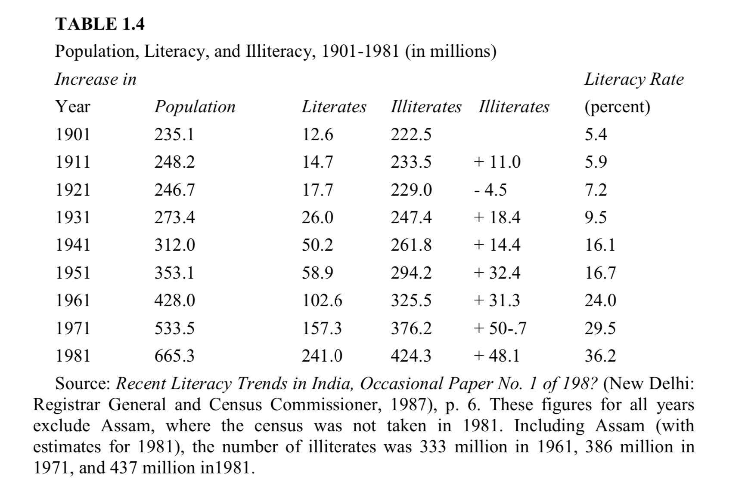

Slide 9
Main Arguments
Government has accepted child labour as a “harsh reality”
Haven’t given up goals of ending child labour, but cannot be implemented currently because of prevailing social and economic conditions:
Chronic poverty
Parents do not believe they will benefit economically through education
Belief that children acquire skills through employment not education
Employers prefer children for cheap labour, supple fingers, more pliable
Notes:
So government proposes that measures be taken to improve the working conditions of children rather than remove them from the work forces
Committee on child labour and India’s Education Ministry have attitudes of letting children be in the workforce rather than promoting compulsory primary education

Slide 10
Main Arguments
State thus ought not to intervene as a matter of “social justice” for the poor
With improvement in employment and income of the poor, they will automatically send their children to school
Changes in technology will reduce demand for unskilled child labour
Improvement in national budget will allow government to spend more on primary edu.

Slide 11
Counter Evidence from other Countries
No clear relationship between literacy and per capita income
Spectacular primary-school attendance rates achieved even before rapid economic growth
Resource constraints are also not a sufficient explanation
Notes:
Literacy and per capita income -- China, Indonesia, Tanzania, Philippines all have more
Prior to rapid economic growth -- Japan, South Korea, China

Slide 12
Takeaways
Lack of India’s efforts stem from attitude of important actors towards child labour and compulsory primary education
Most harmful - attitudes of officialdom - government, ministries, committees, ministries
Very little political support for both

Slide 13
India’s Working Children
Smriti Jalihal

Slide 14
Who are these children?
From families who have a very low per capita income
Children are forced to work
Agricultural workers, bonded laborers
Ex- untouchables
University of Hyderabad- Study showed that 9,00,000 boys and 6,46,000 girls enrolled in grade 1 in Andhra Pradesh and 2,30,000 boys and 1,26,000 girls enrolled in grade 5
All child laborers are not reported as some help their parents in small cottage industries
Time period: 1985-1990

Slide 15
Legislation
Laws: Factories Act of 1948 (Units employing ten or more workers using power and 20 or more workers not using power, cannot employ children)
Employment of Children Act (Prohibition of the employment of children under 14)

Slide 16
Where do these children usually work?
Cottage Industries
Household industries
Factory sheds
Diamond Cutting
Carpet industry
Textile industry
Brassware and bidi manufacturing
Rag pickers

Slide 17
How many child laborers?
NSSO (1983): 17.4 million child laborers
Operations Research Group of Baroda: 44 million

Slide 18
Andhra Pradesh has the highest incidence of child labor (also lowest literacy rate)
Kerala has the lowest incidence of child labor (highest literacy rate)

Slide 19
Bangalore City Market
Case study of a child worker who became a boss and employed more child workers (cyclical effect): more profits as you do not need to pay the minimum wage
Numerous children work as shop assistants- few in school who work part time, others work full time.
Takes a lot of years for pay to increase
Increased because the number of stalls and restaurants have also increased

Slide 20
Street Children of Secunderabad
Numerous children working as beggars, rag pickers, prostitutes and vendors
Violence at home
Centres like Prema Seva Sadan that feeds and houses children who have fled from domestic households
Poor parents come there to admit their children

Slide 21
Match Industry of Sivakasi
Most publicized centre of child labor in India
Largest single concentration of child labor in the world (45,000)
Children employed in match, fireworks and printing industries
Children from nearby villages, agent
Child labor is legally permitted in the small “family owned” workshops, but not in the factories
Violation of Minimum Wages Act
Remedial Measures?! Wages for children to be raised, higher excise tax, children should not have to travel so much, provision of lunches and free health care at workplace

Slide 22
Glass Factories of Firozabad
Children are paid 10 rupees per 12 hour shift and their daily wage doubles when they are old enough to blow glass
Labor Law Department of Government of Uttar Pradesh- 13% of the 70,000 workers there are children

Slide 23
Pottery Industry of Khurja
5000 children employed
Most children are the kids of potters who work in the same factories
Children who joined the factory earlier, earned more as compared to others later in life
Relation between early entrance into labor force, nutrition and life time wage earning capacity

Slide 24
Village Near Pune
Unpaid domestic work
Non formal education program
Instruction of basic health and science
Children did not regard their parents decision of schooling as choiceless

Slide 25
Takeaways
Child labor in India is largely a preindustrial, precapitalistic labor force
Child labor in India is not the product of industrialism and capitalism, but represents the persistence of the traditional role of the child as a worker
Most child workers are illiterate
Few children outside of agriculture can be said to be apprentices learning traditional family skills – engaged in relatively new occupations
The “skills” acquired by the children are rarely those that could not be acquired at an older age. Indeed, the skills are typically of a low level: simple, routinized, manual tasks or carting

Slide 26
Early entrance into the labor force is no assurance of a higher wage later. Wages paid to adults are not determined by whether or not they worked as children
Restrictions on child labor has led to the sprouting of smaller factories where conditions are worse and wages are lower
Financial contributions by children to household income are often small

Slide 27
India’s Position on Child Labour (Quick in understanding, but slow in improvement)
Muskan Agarwal

Slide 28
Ideal
Reality
Work in all its forms, paid or unpaid in any processes or occupations which affects the proper and full development of a child should be prohibited for all children up to the age of 14 on an urgent basis and they be provided with quality education and enabling environment for their all-round development.
According to Census 2011, number of child laborer's in India between 5-14 years is 4.35 million (main workers) and 3.87 million (marginal workers), which comes to a total of 8.22 million.

Slide 29

Legal Frameworks & Provision

Slide 30
International Legal Arrangements
Article 32 of UNCRC
ILO Convention
New SDG
Article 32 of the UNCRC “recognizes the right of the child to be protected from economic exploitation and from performing any work that is likely to be harmful or to interfere with the child’s education, or to be harmful to the child’s health or physical, mental, spiritual, moral or social development.”
The ILO Convention, 1973 (No. 138) states that, “Any work which is likely to jeopardize children’s physical, mental or moral health, safety or morals (is hazardous and) should not be done by anyone under the age of 18.”
The New Sustainable Development Goals urge governments to commit that “By 2030, ensure that all girls and boys complete free, equitable and quality primary and secondary education leading to relevant and effective learning outcomes”. It also states that governments should “Take immediate and effective measures to eradicate forced labour.

Slide 31
Constitutional Framework
Article 24 of the Constitution of India protects children below the age of 14 against being employed in any hazardous activities.
Article 23 prohibits trafficking and forced labour.
Article 21A specifically states the right to education for all children between the age of 6 and 14.
Article 39 under the directive principles requires the States to ensure that children are protected against abuse and not forced to enter a vocation not suited to their age or strength.
Article 15 of the constitution enables the government to make such laws and policies that protect the rights of children and ensure their well-being.

Slide 32
National Provision
Main Act: Child Labour (Prevention and Regulation) Act, 1986.
Details: Children are prohibited from employment in certain specified occupations and processes below the age of 14.
Other Acts
The Factories Act, 1948
The Motor Transport Workers Act
The Bonded Labour System (Abolition) Act, 1976
The Juvenile Justice Act, 2000
Set out minimum age of employment for children and regulate working conditions such as time and hours of work.
Set out minimum age of employment for children and regulate working conditions such as time and hours of work.
Deals with rehabilitation, care and protection of children in need of care and protection or children in conflict with law.
Prohibits any form of bonded or forced labour in the country.

